Slide 1
CSE-3213
Computer Graphics Lecture 01

Slide 2
TEXT BOOK
Introduction to Computer Graphics
using Open GL
by Donald Hearn and M. Pauline Baker
published by Prentice Hall

Slide 3
Syllabus

Slide 4
Syllabus

Slide 5
Definition
Computer Graphics
The term computer graphics describes any use of computers to create and manipulate images

Slide 6
Graphics Area
Modeling deals with the mathematical specification of shape and appearance properties in a way that can be stored on the computer.
Rendering is a term inherited from art and deals with the creation of shaded images from 3D computer models.
Animation is a technique to create an illusion of motion through sequences of images.

Slide 7
Typical Application Areas
Plotting in Business
2D or 3D graphs
Office Automation
MS Word, MS Excel, MS PowerPoint
Desktop publishing
Designing documents

Slide 8
Typical Application Areas
Plotting Science and Technology
2D or 3D graph, line drawing, surface plot, pi chart etc.
Web/business/commercial publishing/advertisement
On the web, commercial shoot outs, banner
CAD/CAM design
VLSI, circuit design, architectural and civil engg.
drawings
Scientific Visualization
Nuclear explosion, biological or mechanical sciences

Slide 9
Typical Application Areas
Entertainment
Movies, TV advertisements, Games etc.
Cartography
Digital maps.
Multimedia
Text, audio, video graphics
Virtual Reality
Games, animation
Digital Image Processing
Digital picture

Slide 10
Application Examples

Slide 11
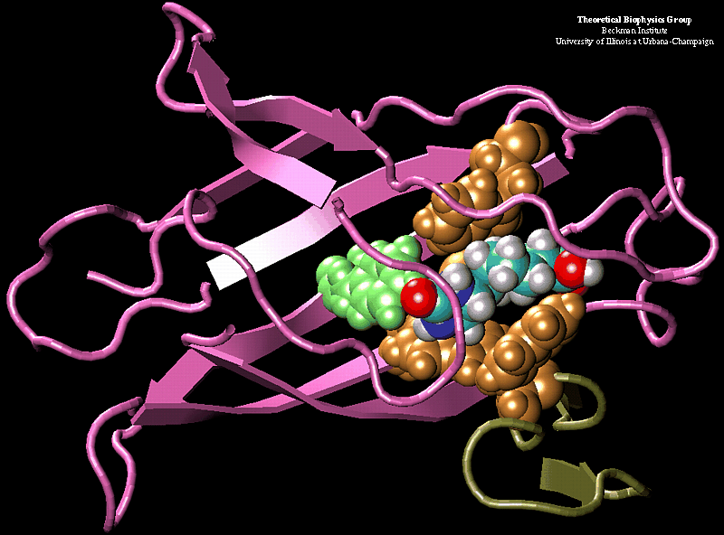
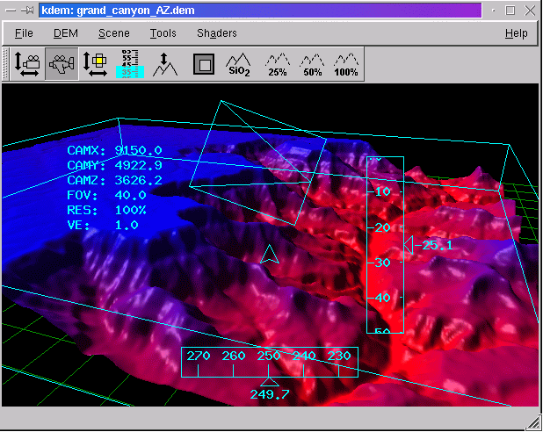
Scientific Visualization and Analysis

Slide 12
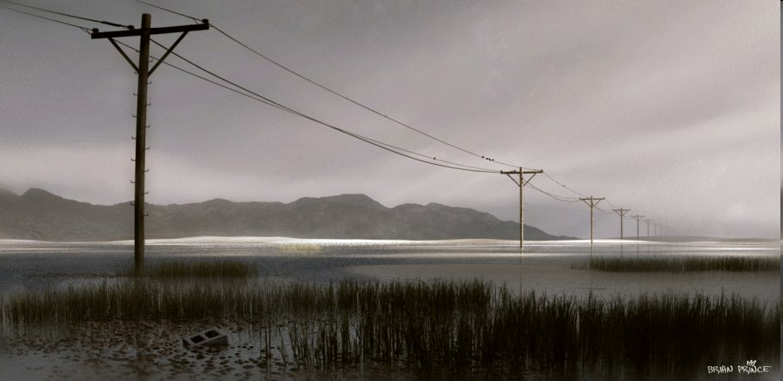
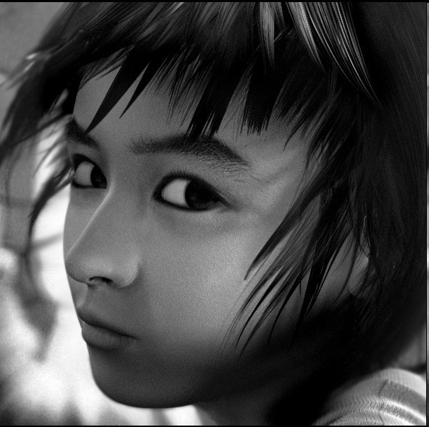

ART AND DESIGN

Slide 13
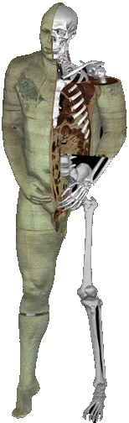
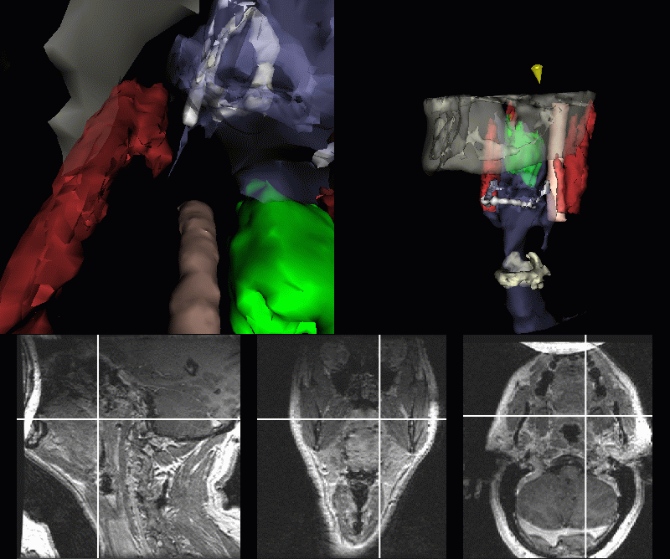
Medicine and Virtual Surgery
The Visible Human project

Slide 14
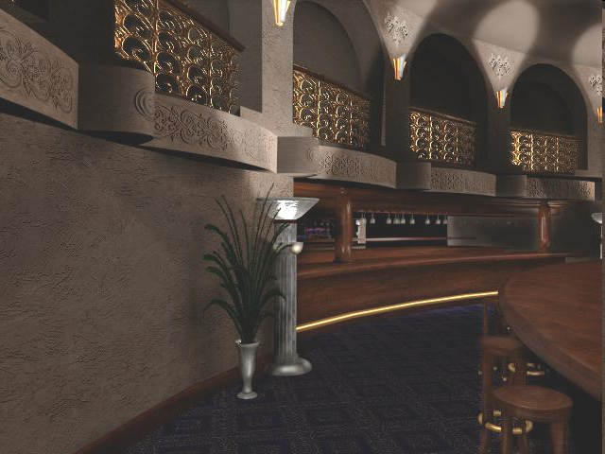
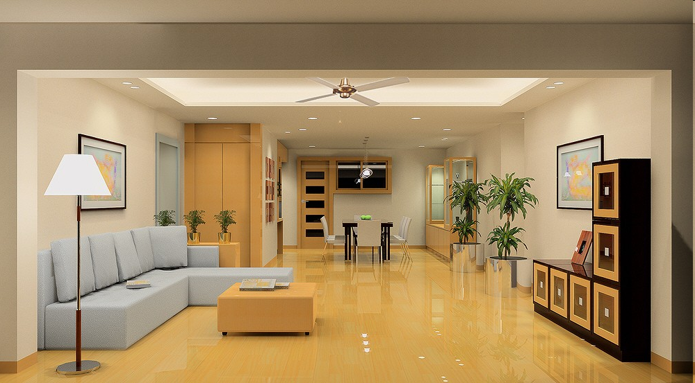
Room Layout Design and Architectural Simulations

Slide 15
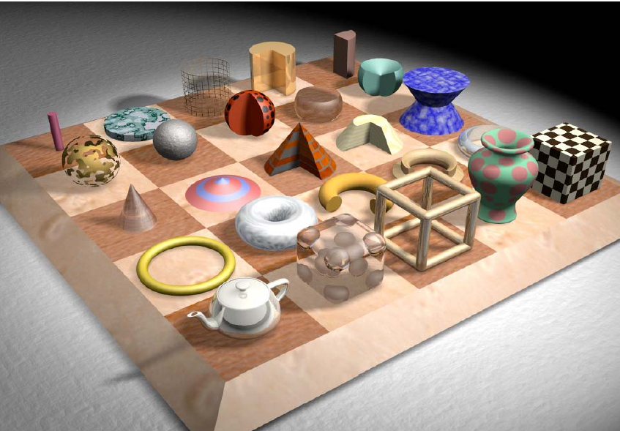
Layout Design & Architectural Simulations

Slide 16
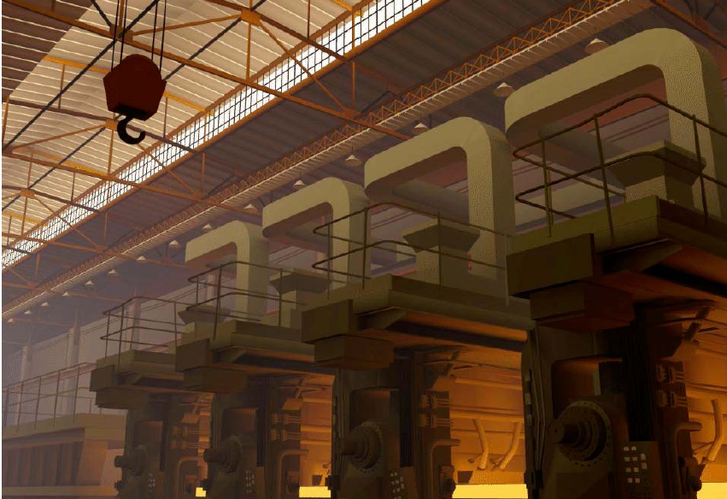
Layout Design & Architectural Simulations

Slide 17
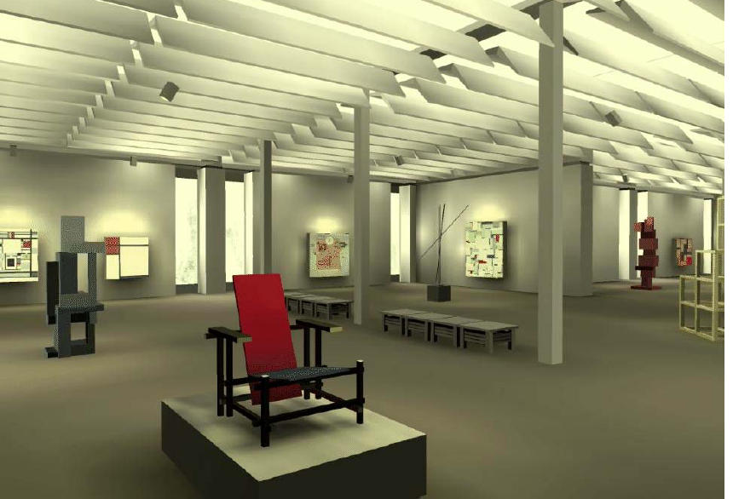
Layout Design & Architectural Simulations

Slide 18
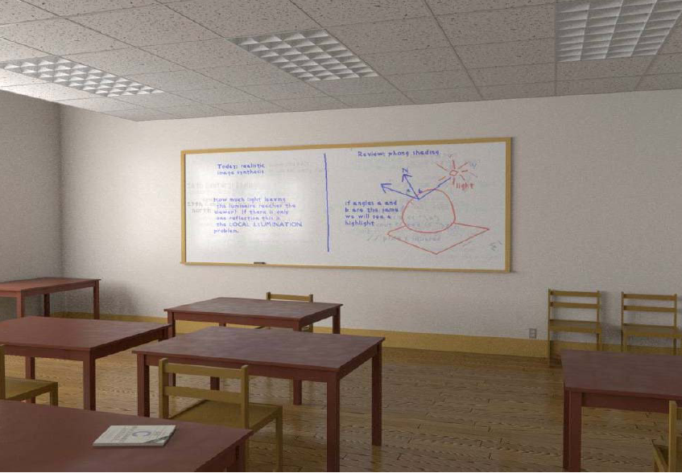
Layout Design & Architectural Simulations

Slide 19
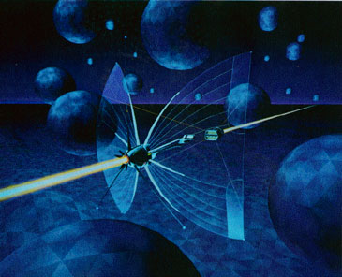
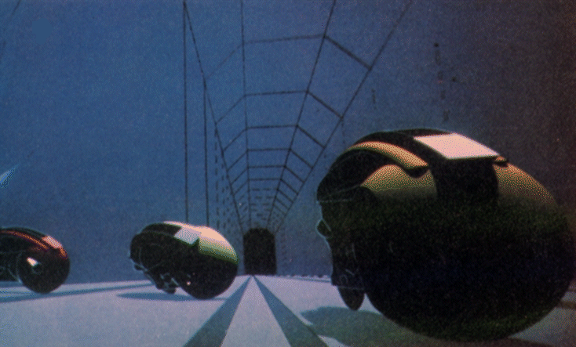
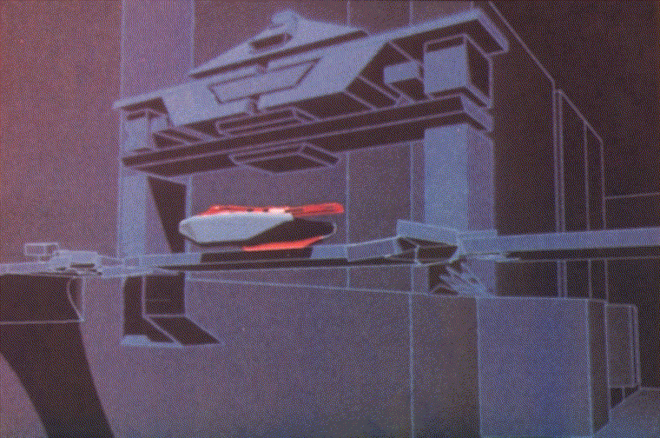
Movies
Tron (1980)
First time computer graphics were used for
live action sequences.

Slide 20
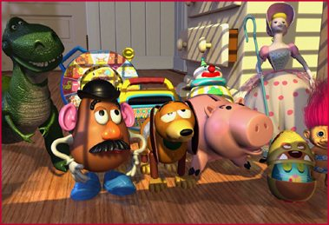


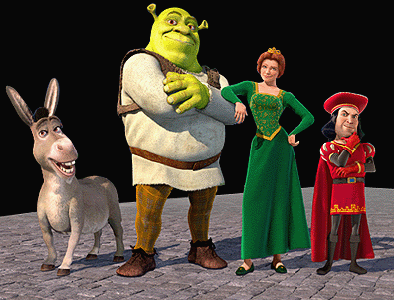
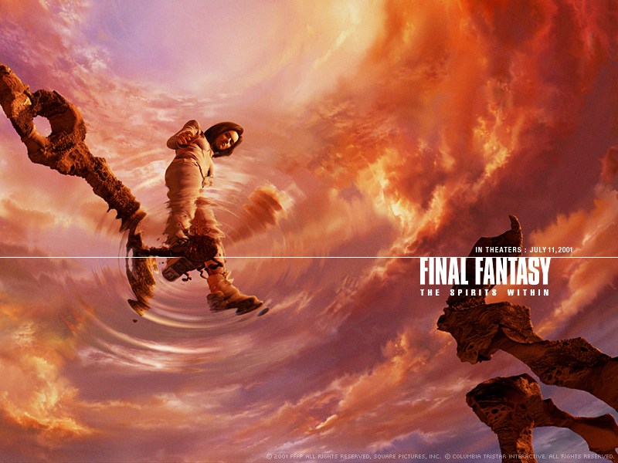
Movies
Fully computer generated animated features

Slide 21
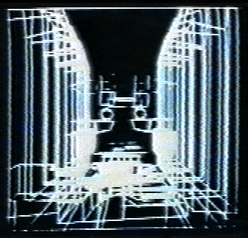
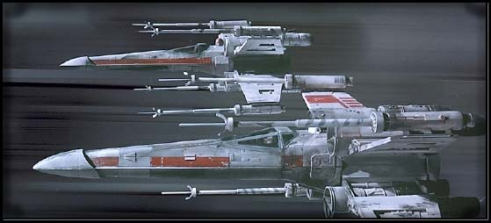
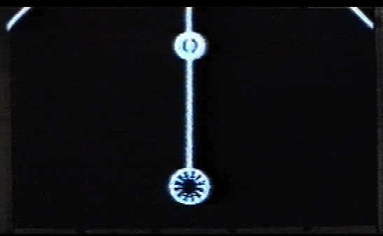
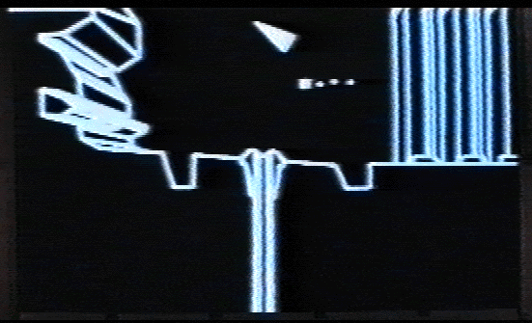
Movies
Star Wars (1977)

Slide 22
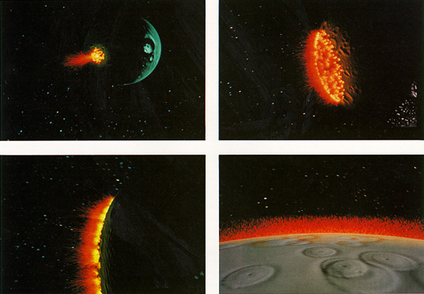
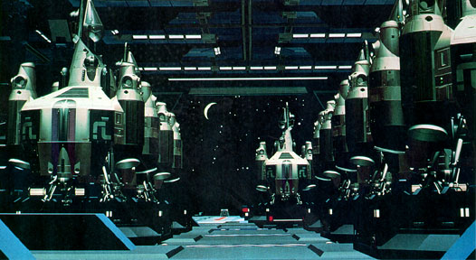
Movies
Star Trek II: The Wrath of Khan, genesis effect (1983)
The Last Starfighter (15 minutes) (1982)

Slide 23
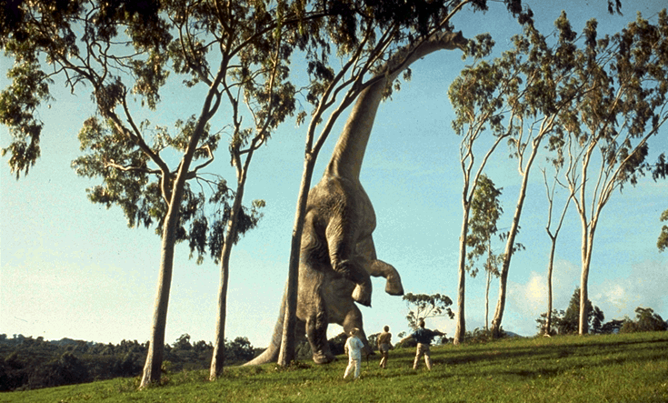
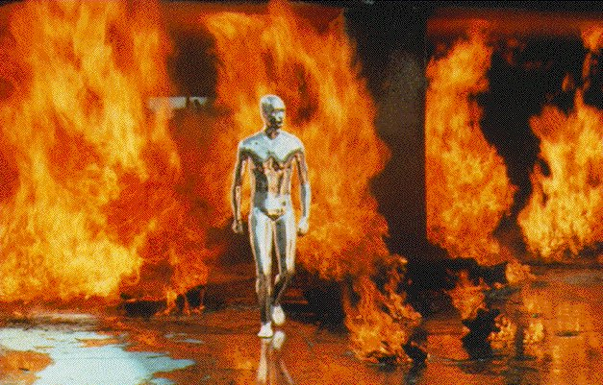
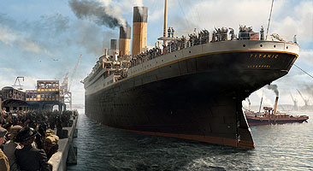
Movies
Special Effects… in Live Action Cinema
Jurassic park, Titanic and T2

Slide 24
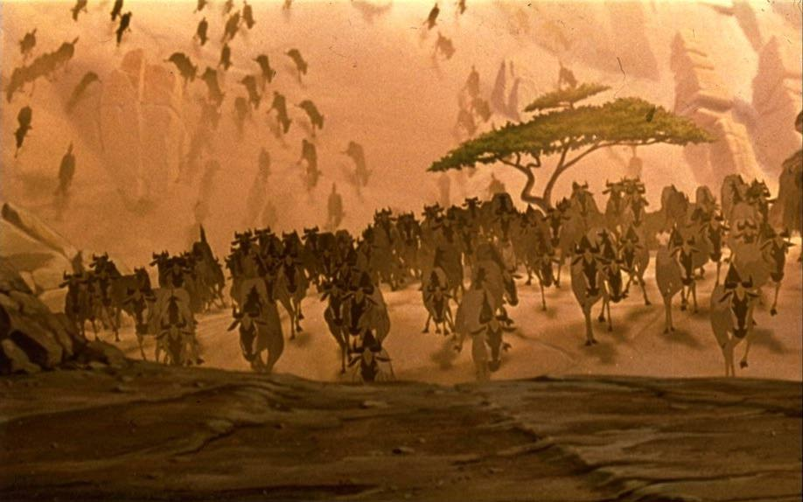
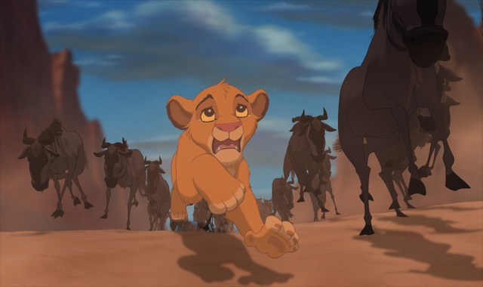
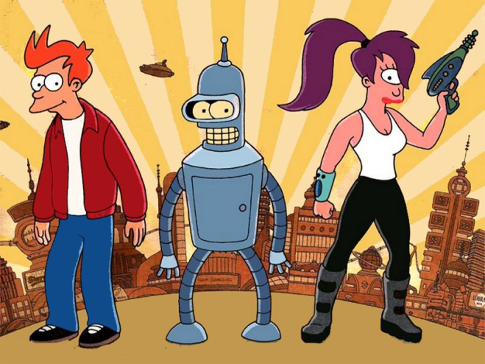
Movies
“Traditional” Animated Features…
Some examples:
Automating Key-framing in many Disney-type animations
The flocking behaviour of the wild-beast in Lion King
Non photorealistic rendering: 3D effects in Futurama

Slide 25
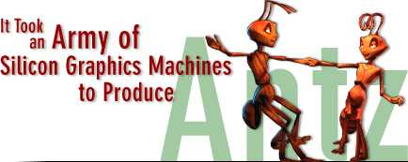
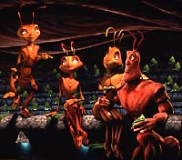
Movies
Behind the scenes on Antz Production
Number of frames in the movie
119,592
Number of times the movie was rendered during production
15 (approx.)
Number of feet of approved animation produced in a week
107 ft.
Total number of hours of rendering per week
275,000 hrs.
Average size of the frame rendered
6 MB

Slide 26
Behind the scenes on Antz Production
Total number of Silicon Graphics servers used for rendering
270
Number of desktop systems used in production
166
Total Number of processors used for rendering
700
Average amount of memory per processor
256 MB

Slide 27
Simulations

Slide 28
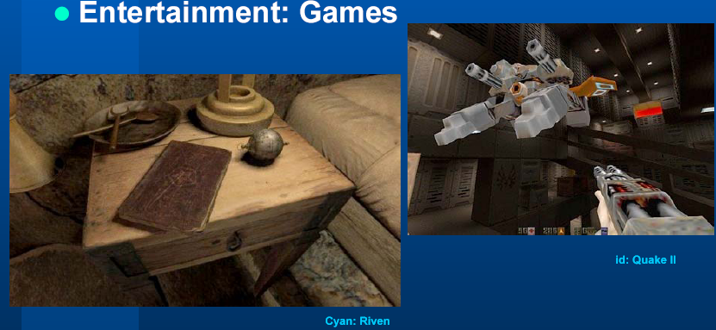
Game

Slide 29


